Slide 1
What are we going to see in this session?
Data sources
Advantages
What can be queried ?
Best possible technique to query the API.
How to pass data fetched to resource & output block
Fetch multiple data sources
Additional possible filters sample

Slide 2
Data Sources
For certain providers like AWS, terraform provides data sources.
Using data source you can fetch the data over API call and use it elsewhere in terraform configuration file.
Data sources provide you the dynamin information.
A lot of data is available by AWS in a structured format using their API.
Terraform also can expose this information’s using data sources.
For Example :
List of AMIs
List of Availability zones
Data source block is declared as “data” followed by resource query and the name of your choice.
While executing terraform plan & apply terraform will execute the data source query and fetch all required information's.

Slide 3
Advantages
What is the advantage of using it ?
It stops you to hardcode any information’s in code.
For example :
If you need to get the image information to create an instance you can use data source query to get that.
Image IDs are dynamic and different for each region, using data source you can just pull these dynamic information’s.
This solution will also enable you to get the latest AMI in any region you’re working just by querying the AWS API.

Slide 4
What can be queried ?
AMI image IDs.
Availability zones
VPC IDs
Security group IDs
EBS volumes
In this example we will see how to query the AMI image ID.

Slide 5
Best possible technique to query the API
Use multiple filters to query the exact match you are looking for.
Use default functions such as “most_recent” to fetch the recent information.
Use owners to fetch ID by owner.
Owners can be
[self] = your own image IDs
[aws-marketplace] = Get images from Amazon marketplace.
[Microsoft] = Images of Microsoft.

Slide 6

Code
Filter by name :
main.tf
data "aws_ami" "my_image" {
owners = ["self"]
filter {
name = "name"
values = ["rhel_server"]
}
filter {
name = "state"
values = ["available"]
}
}
Filter by tag :
main.tf
data "aws_ami" "my_image" {
owners = ["self"]
count = 2
filter {
name = "tag:image"
values = ["rhel_1"]
}
filter {
name = "state"
values = ["available"]
}
}

Slide 7
How to pass data fetched to resource & output block
main.tf
data "aws_ami" "my_image" {
owners = ["self"]
filter {
name = "name”
values = ["rhel_server"]
}
filter {
name = "state"
values = ["available"]
}
}
resource "aws_instance" "ds_ec2" {
ami = data.aws_ami.my_image.id
instance_type = "t2.micro"
}

Slide 8
Fetch multiple data sources
main.tf
# Provider :
provider "aws" {
region = var.AWS_REGION
}
data "aws_availability_zones" "mumbai" {
state = "available"
}
output "zone" {
value = data.aws_availability_zones.mumbai.names
}
Code : git-repo [file path : Terraform-Documents/Codes/E12_data_source]
Code : git-repo [file path : Terraform-Documents/Codes/E13_data_source_list]

Slide 9
Additional possible filters sample
main.tf
data "aws_ami" "my_image" {
owners = [“self”]
most_recent = true
filter { name = "name” values = ["rhel_server"] }
filter { name = "state” values = ["available"] }
filter { name = "virtualization-type" values = ["hvm"] }
filter { name = "architecture" values = ["x86_64"] }
Similarly there are several possible valid keys which you can filter, you can just go through this link for more information.

Slide 10
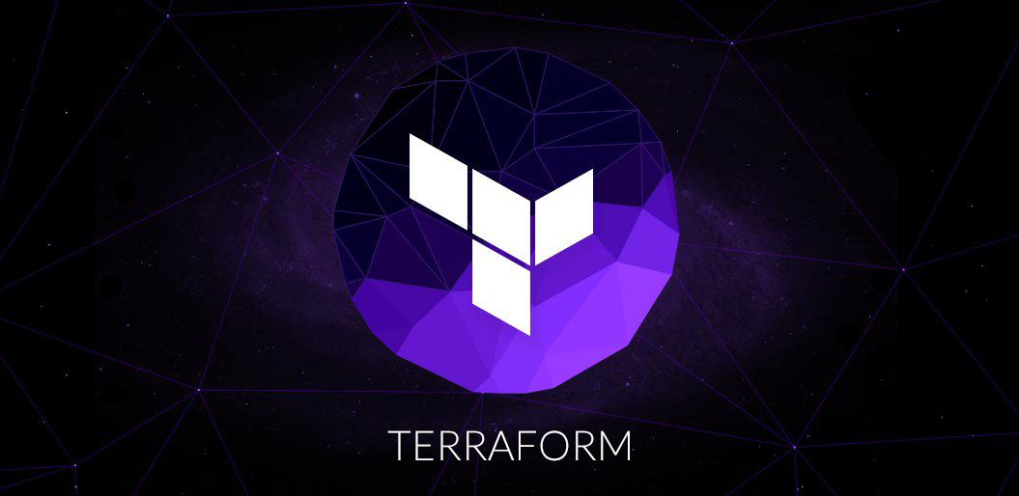
End of this topic !
Any questions?

